Slide 1
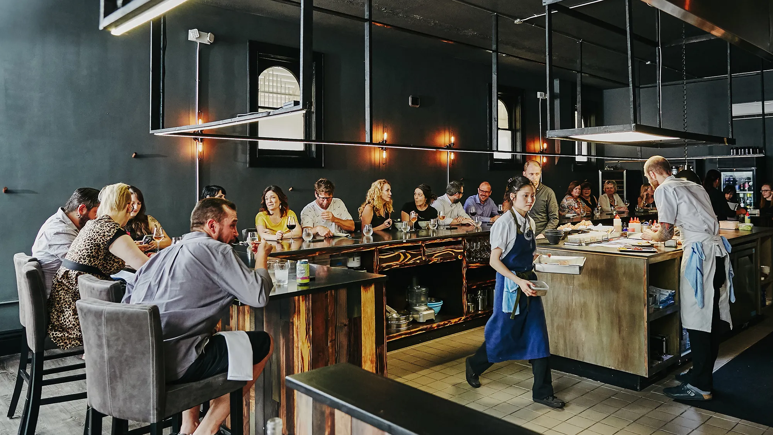
RESTAURANT
MANAGEMENT SYSTEM

Slide 2

Table of Content
UI/UX
Designing
Wireframe and prototype
design
Development (Frontend & Backend)
Objectives
Requirements & Limitations
Milestones
Resource Management
GANTT Chart
WBS
Risk Management
Project
planning and initiation
Integration & Testing
Deployment & Post Launch
1
2
3
4
5

Slide 3

Objective
Design an efficient software solution for managing various aspects of a restaurant’s operations, such as orders, reservations, and inventory.

Slide 4
Requirements
Limitations
Order Management
Time: 15 Week
Reservation System
Budget: Rs.600K
Inventory Tracking
Scope: Multiple Restaurant
Report Generation

Slide 5
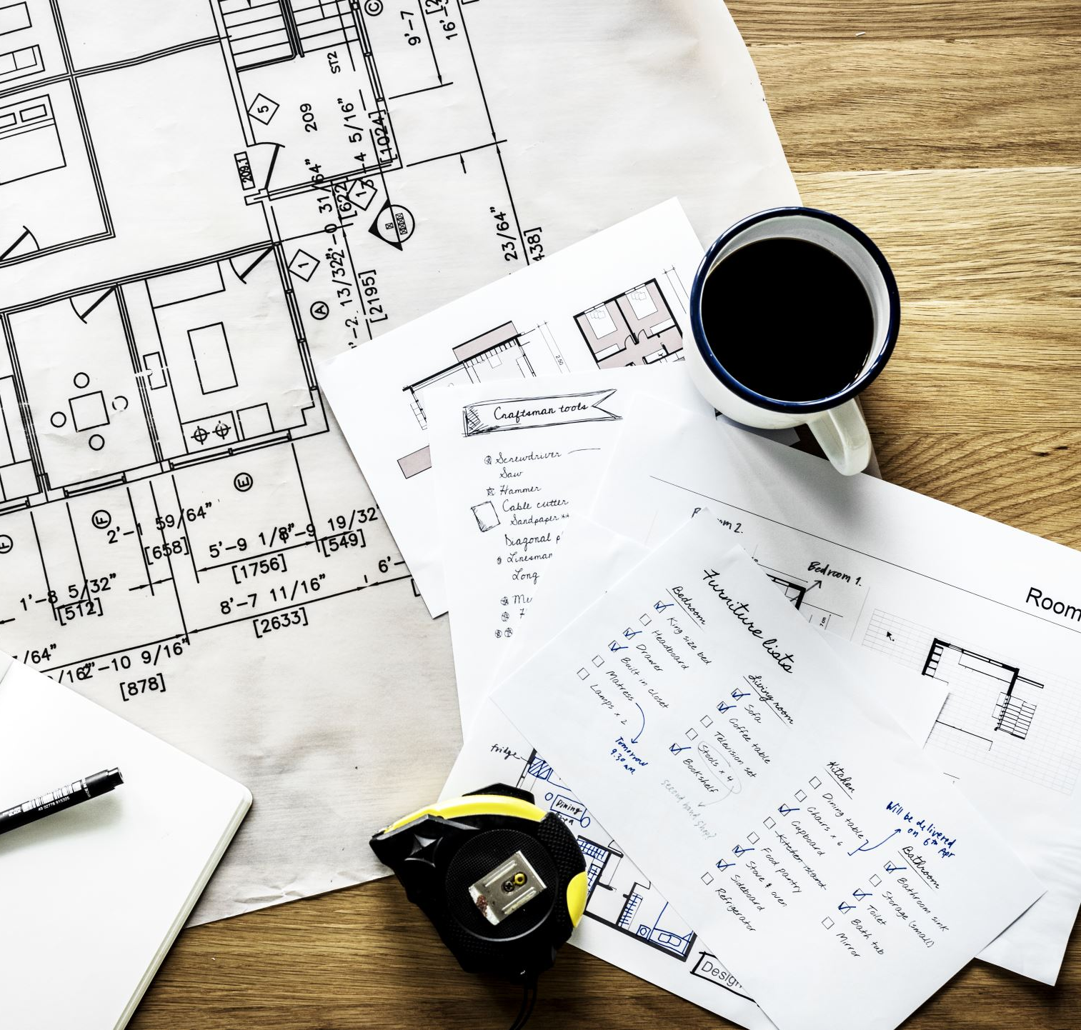
PROJECT MANAGEMENT PLAN
UI/UX
Designing
Wireframe and prototype
design
Development (Frontend & Backend)
Project
planning and initiation
Integration & Testing
Deployment & Post Launch
1
2
3
4
5

Slide 6
Milestones
UI/UX
Designing
Wireframe and prototype
design
Development (Frontend & Backend)
Project
planning and initiation
Integration & Testing
Deployment & Post Launch
1
2
3
4
5

Slide 7

RESOURCE MANAGEMENT
Project Manager
Team Lead
Software Developers (2)
UI/UX Designer
Database Administrator
QA Tester

Slide 8
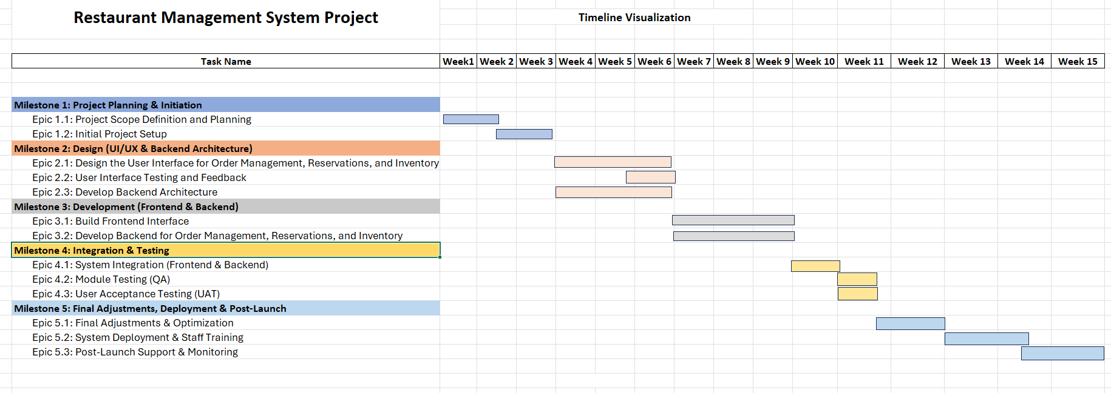
GANTT CHART

Slide 9

WORK BREAKDOWN STRUCTURE

Slide 10
Milestone 1
Milestone 2
Milestone 3

Slide 11

RISK MANAGEMENT

Slide 12
Potential Risks
Mitigation Strategies
Technical Difficulties
Scope Creep
Integration Challenges
Data Security
Regular Code Review
Define Scope
Conduct Early Tests
Encryption Techniques

Slide 13

Thank You

